Slide 1

Workshop: How to Make an R Package?
By You Zhou
26.02.2026

Slide 2
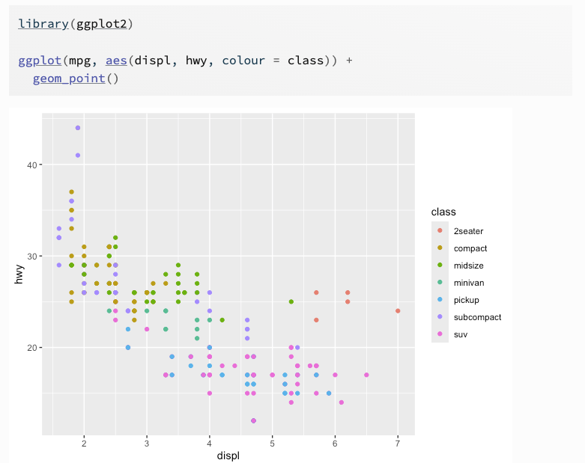
What is R package?
Definition: R packages are collections of functions and/or data sets which can be used in R and developed by the community.

Slide 3



Where can we submit an R package?
The Comprehensive R Archive Network (CRAN)
GitHub
Bioconductor

Slide 4
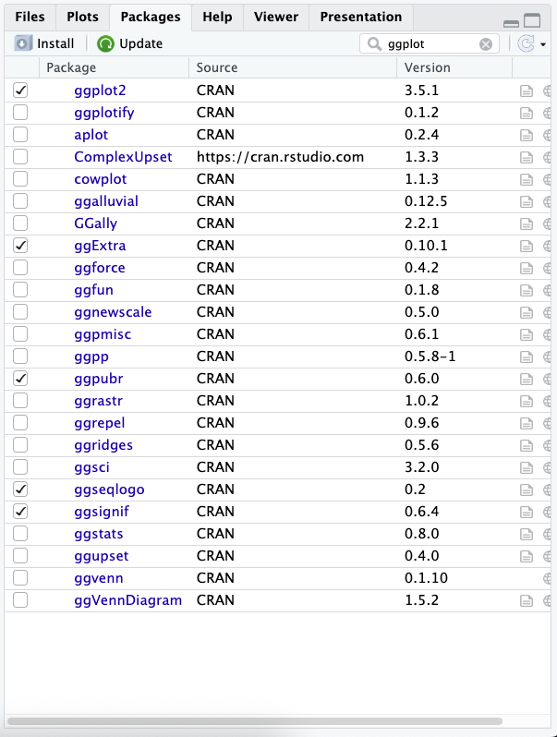
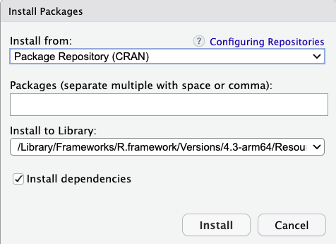
CRAN
CRAN, the central software repository for R, is supported by the R Foundation and hosted 23,231 packages as of Feb. 2026.

Slide 5
The Comprehensive R Archive Network (CRAN)
GitHub
Bioconductor

Slide 6
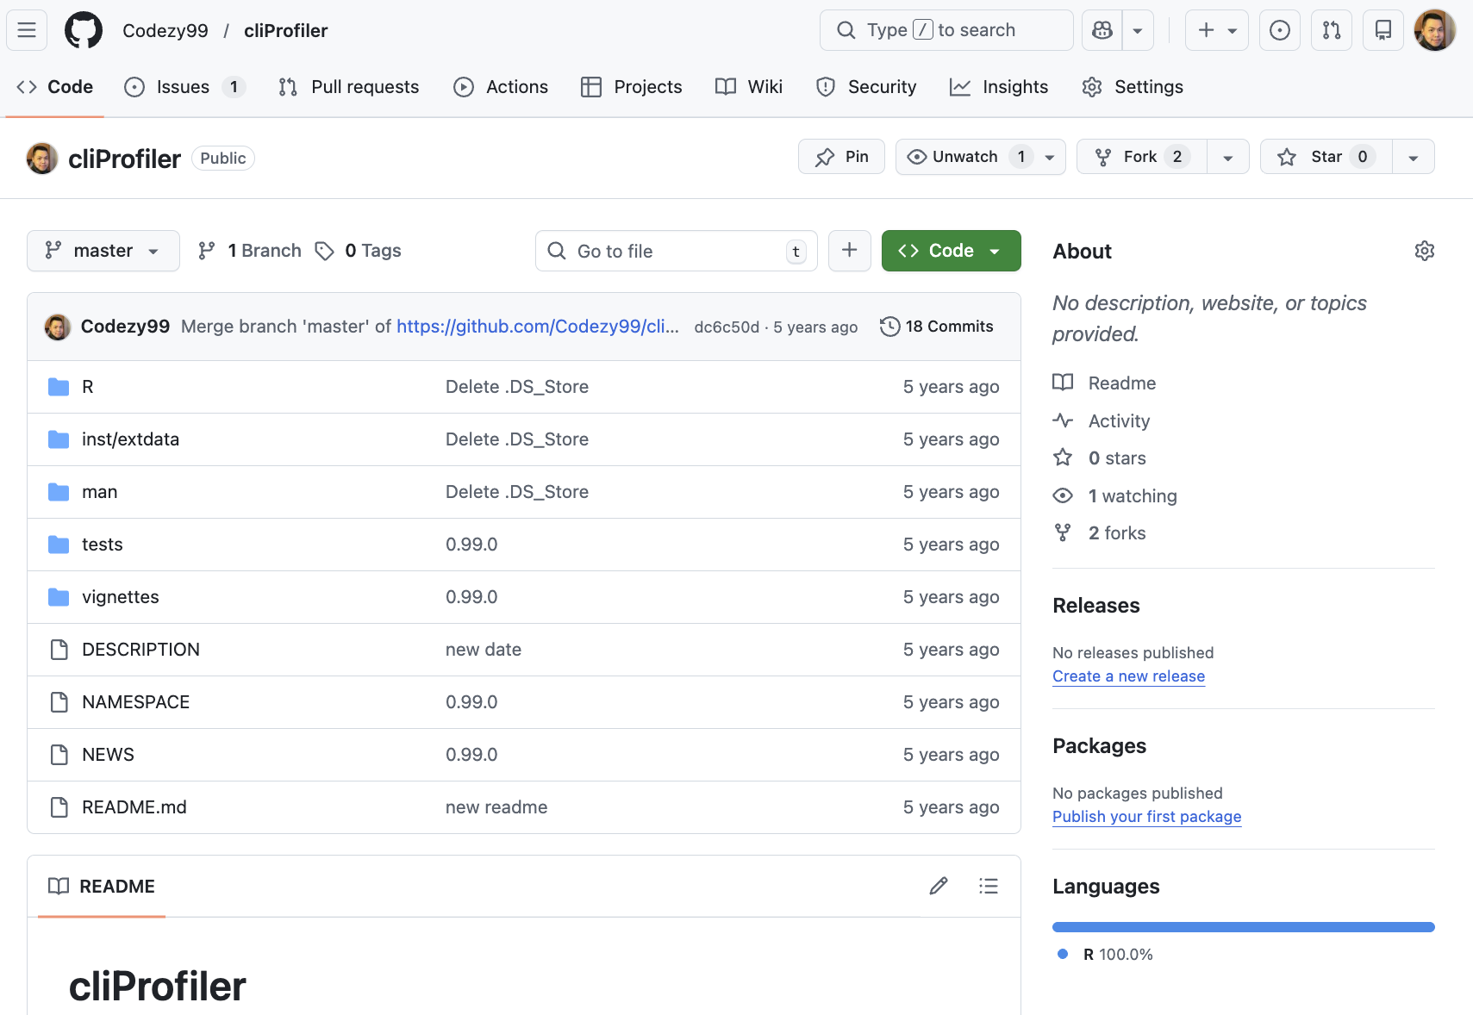
GitHub
GitHub is an online platform for hosting, versioning, and collaboratively developing code using Git.

Slide 7
The Comprehensive R Archive Network (CRAN)
GitHub
Bioconductor

Slide 8
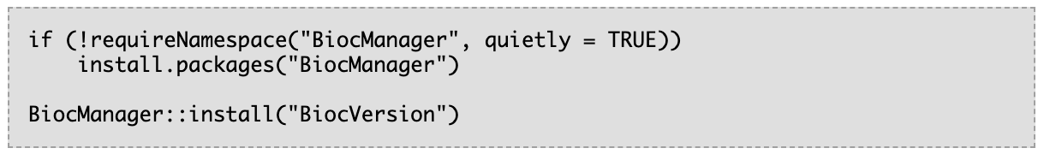
Bioconductor
Bioconductor provides tools for the analysis and comprehension of high-throughput genomic data. Bioconductor uses the R statistical programming language and is open source and open development. It has two releases each year, and an active user community.

Slide 9
How to choose where to submit your package?
Choose CRAN if your package is mostly:
general statistics / utilities / plotting / machine learning helpers
not dependent on Bioconductor core data structures
intended for broad R users beyond bioinformatics
Choose Bioconductor if your package is mostly:
genomics / transcriptomics / proteomics / epigenomics / single-cell / spatial omics
using Bioconductor classes (GRanges, IRanges, SummarizedExperiment, etc.)
intended for biological data analysis pipelines

Slide 10
Package dependencies
Bioconductor packages can depend on CRAN and Bioconductor packages.
CRAN packages should generally avoid depending on Bioconductor packages (can complicate CRAN checks and installation for users).

Slide 11
How to develop a package for Bioconductor?

Slide 12

The first thing for developing a Bioconductor package
https://jerichovt.org/share-your-ideas

Slide 13
Workflow for package development
Idea
What question you would like to solve with this package?
Name
Checking whether the name of package is available
Set up
Set up your package with RStudio and GitHub
Function
Write your functions
Write the documents
Write the DESCRIPTION, NAMESPACE and other documents
Submission
Submission
Checking
R CMD check and BiocCheck

Slide 14
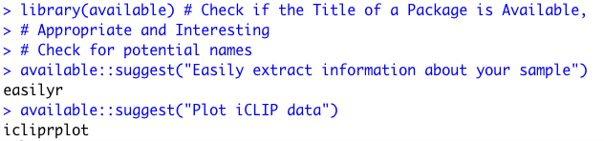
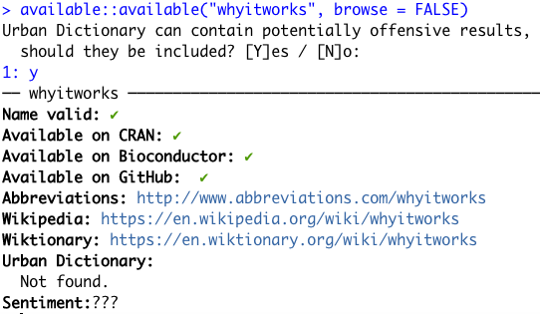
Checking whether the name of package is available

Slide 15

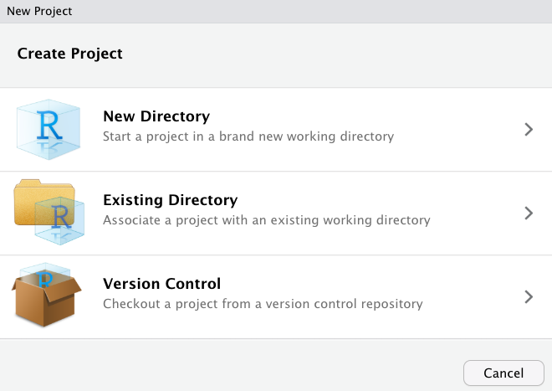
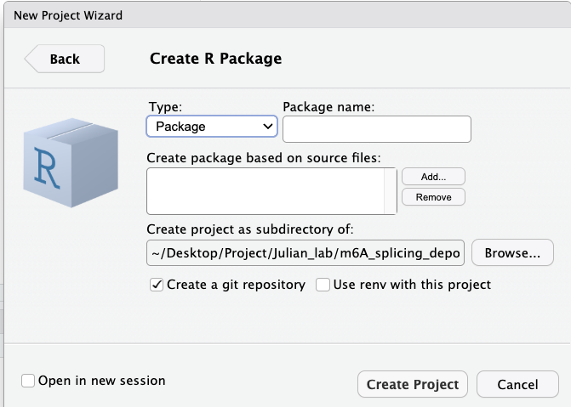
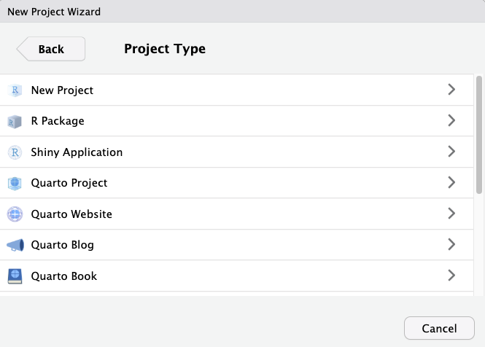
Set up your package with RStudio and GitHub

Slide 16
Using the correct version of R and Bioc-devel
R has a ‘.y’ release in x.y.z every year (typically mid-April), but Bioconductor has a .y release (where current devel becomes release) every 6 months (mid-April and mid-October).
This means that, from mid-October through mid-April, Bioconductor developers should be developing against R-devel. From mid-April to mid-October, developers should use R-release (actually, the R snapshot from the R-x-y-branch) for Bioconductor development.

Slide 17
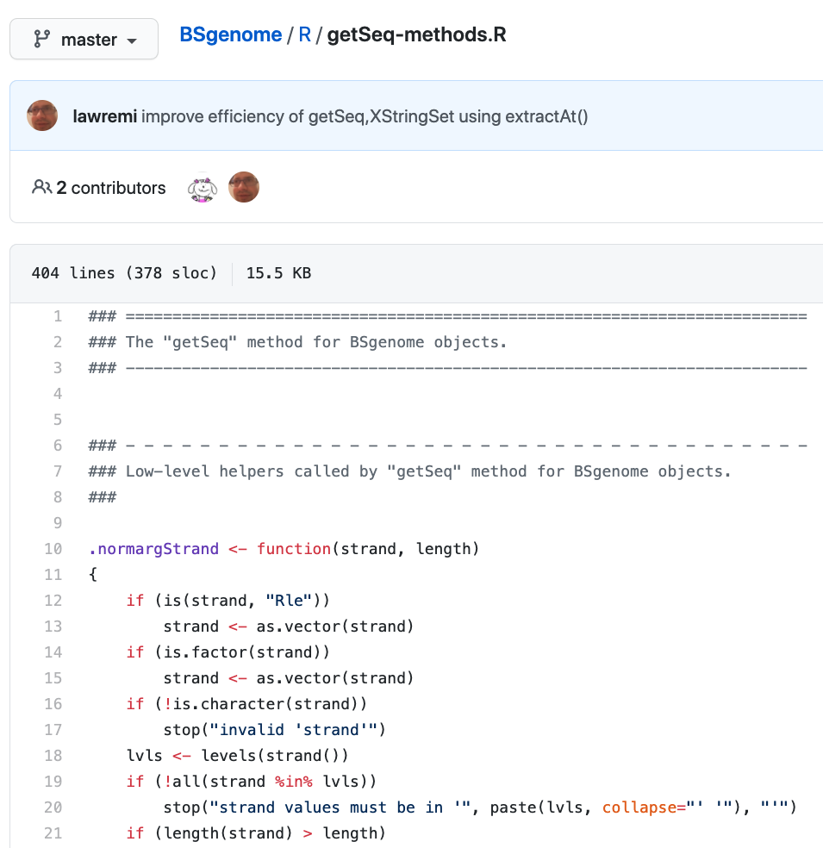
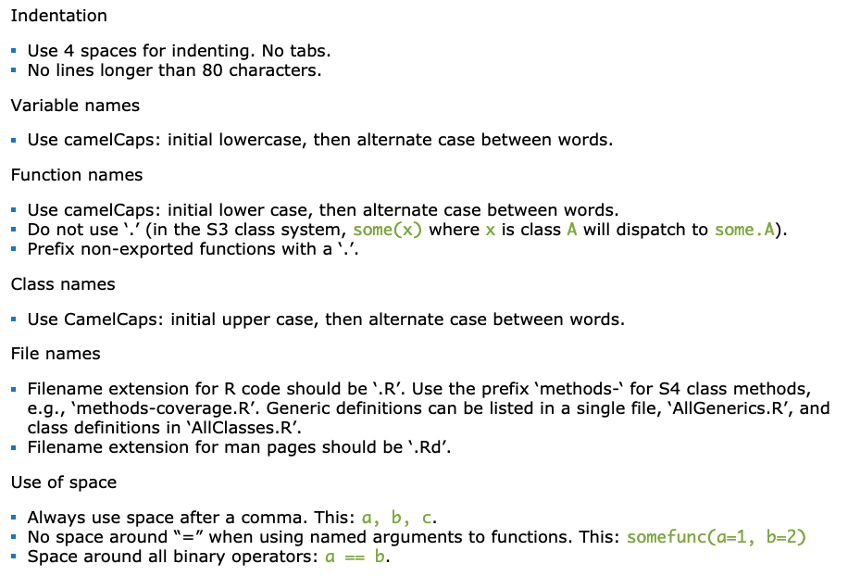
Coding style

Slide 18

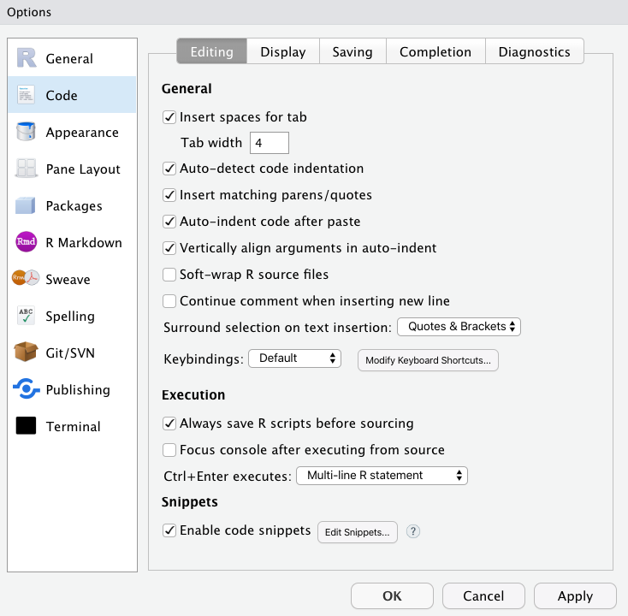
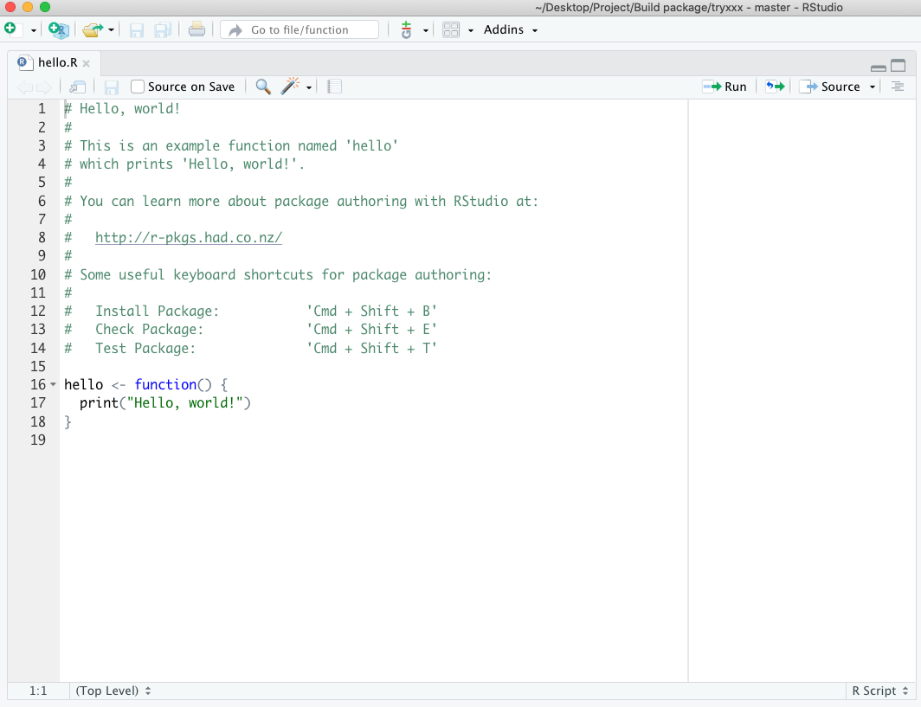
Some settings that make life easier

Slide 19
S3 and S4 object system
S3 implements a style of Object-oriented (OO) programming called generic-function OO. This is different from most programming languages, like Java, C++, and C
S4 works similarly to S3 but is more formal.

Slide 20
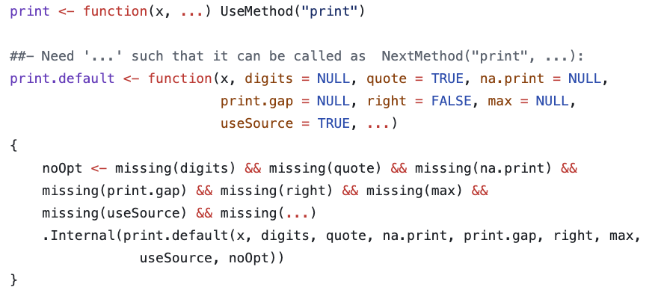

S3 objects
S3
Positive:
CRAN, simple but powerful
Flexible and interactive
Uses a generic function
Negative:
Bad at validating

Slide 21
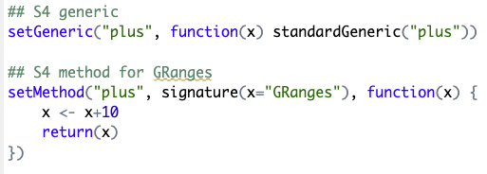


S4 objects
S4
Positive:
Formal definition of classes
Bioconductor reusability
Easy to check input types
Negative:
Complex structure
S4 function can restrict the input data types!

Slide 22
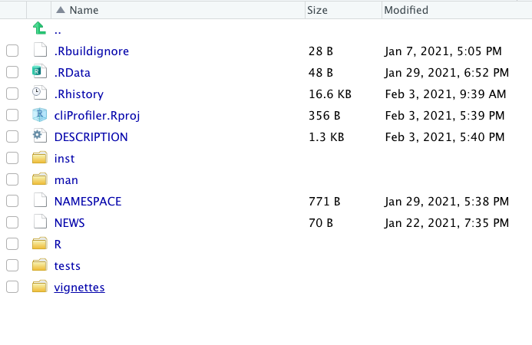
Documents in the package

Slide 23
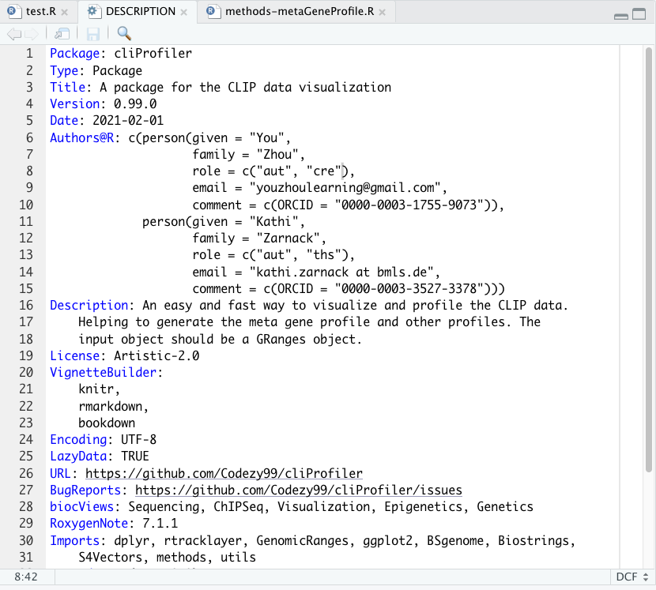
DESCRIPTION

Slide 24
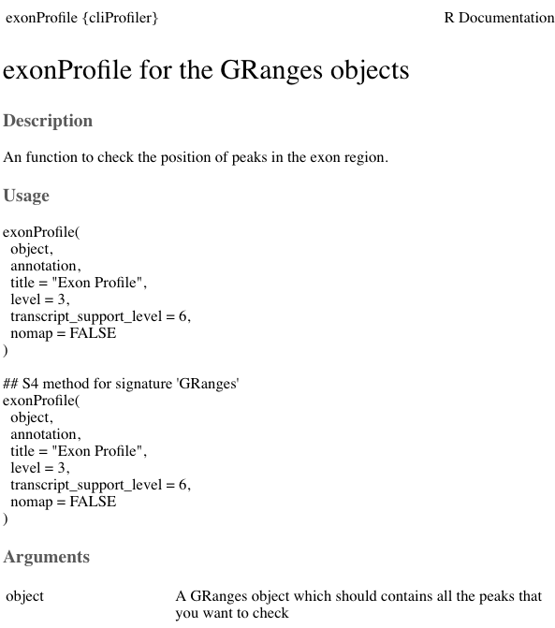
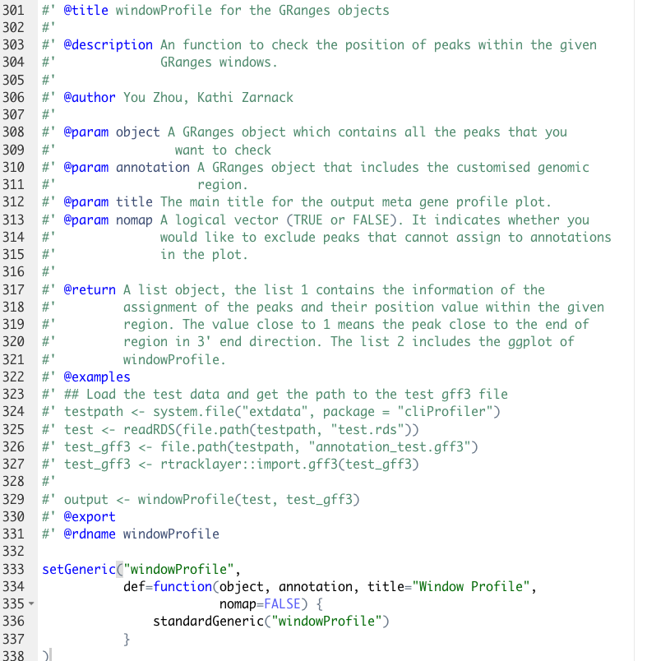
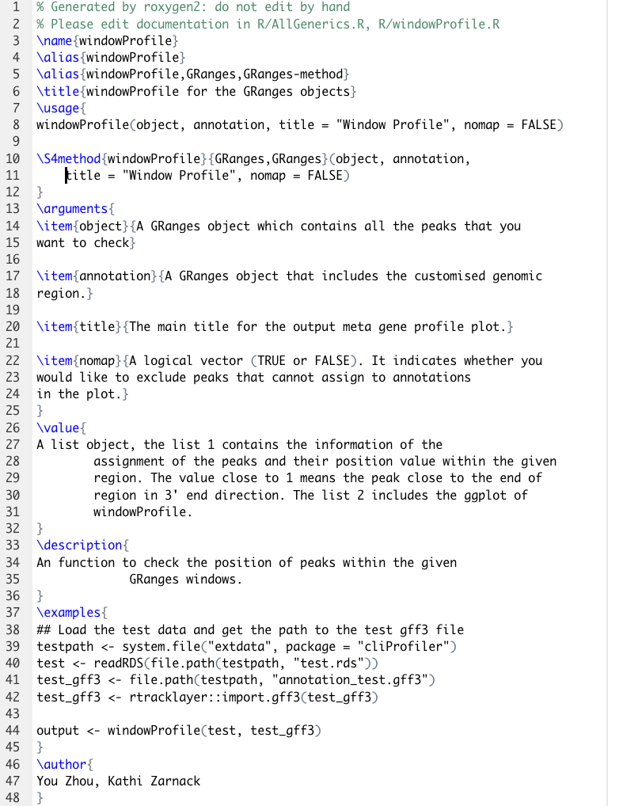
Roxygen2 can help to generate files in man folder and NAMESPACE

Slide 25
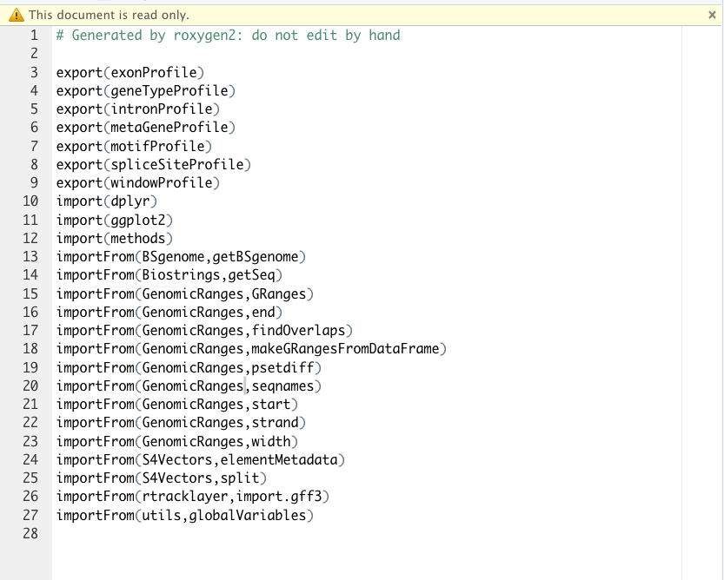
NAMESPACE

Slide 26
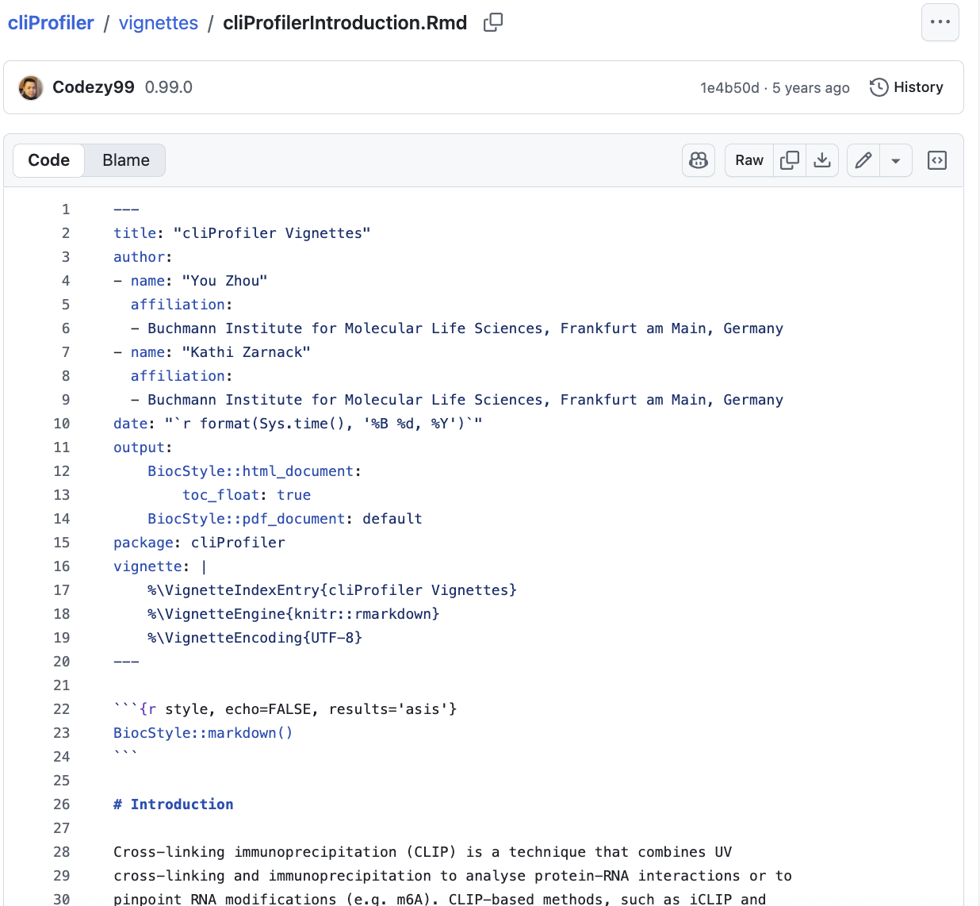
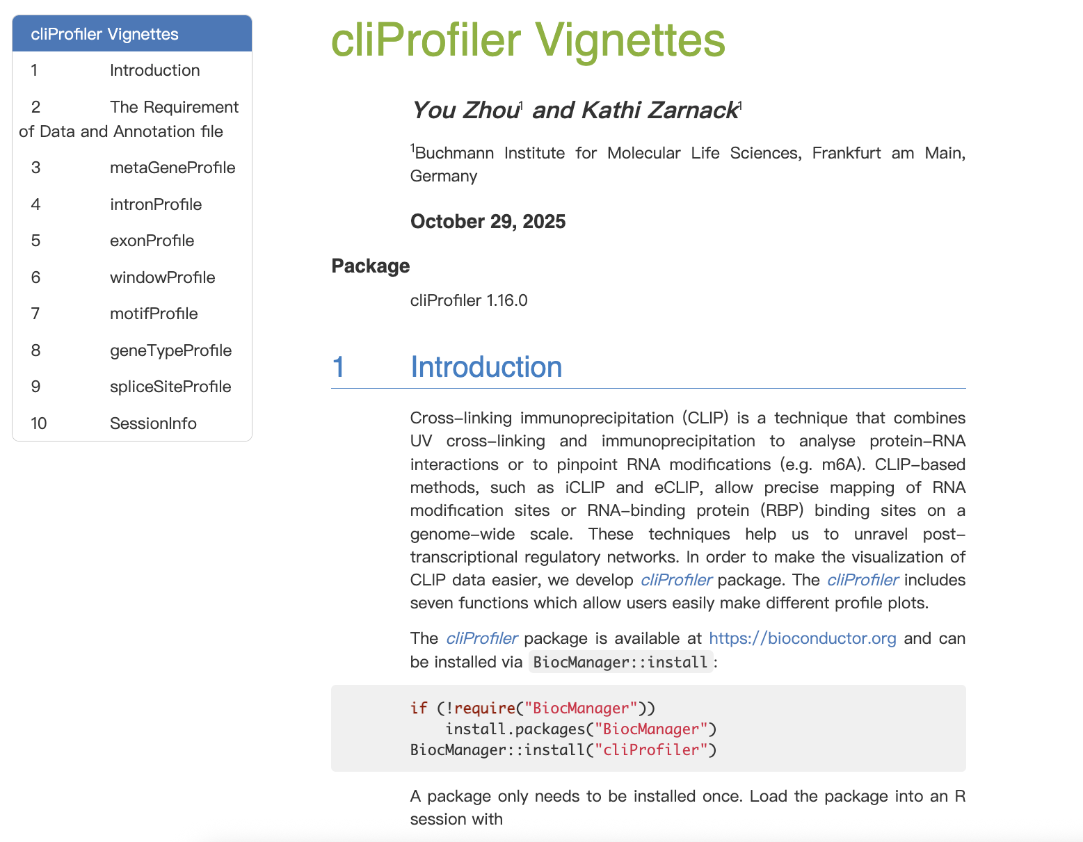
Vignettes (Rmd)

Slide 27
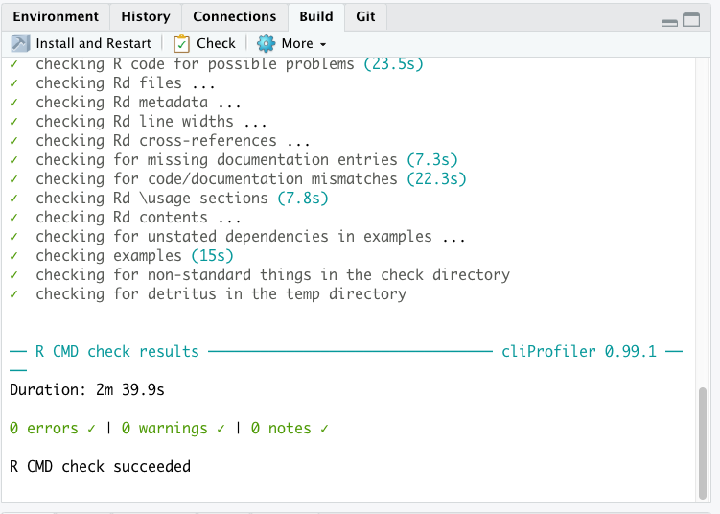
Checking

Slide 28
Thank you for your attention : )

